Slide 1
Biostats Boot Camp – Session 4
A. Biswas, P. Wilson

Slide 2

Confounding
@fperrywilson

Slide 3

#1 Rule of observational studies
Correlation ≠ Causation
@fperrywilson

Slide 4
How Alcohol Affects Grade point average
GPA
Drinks per Weekend
Singleton, RA: J Stud Alc and Drugs. 2015
@fperrywilson
Notes:
Monitor 2: Maybe a drink Icon
236 students. For every extra weekend drink, GPA goes down by 0.28 points.

Slide 5

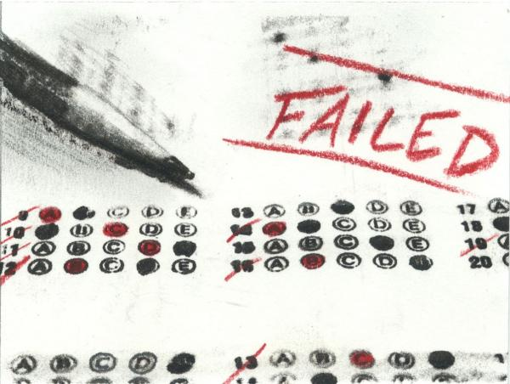
Probing Causality: The Conceptual Model
@fperrywilson
Notes:
Monitor 2: just need to replace this stuff with icons – I think Baxter had done a sample using this very lecture so hopefully we can use that.

Slide 6
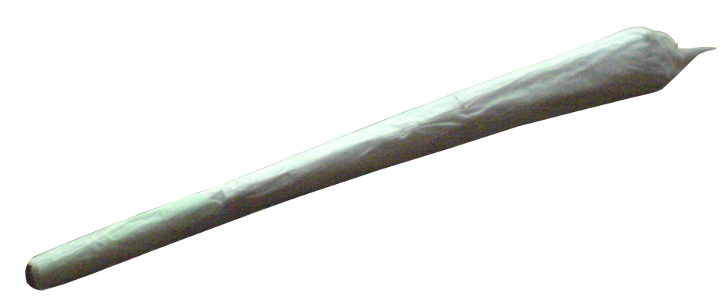
Probing Causality: The Conceptual Model
@fperrywilson
Notes:
Monitor 2: just need to replace this stuff with icons – I think Baxter had done a sample using this very lecture so hopefully we can use that.

Slide 7

Probing Causality: The Conceptual Model
@fperrywilson
Notes:
Monitor 2: just need to replace this stuff with icons – I think Baxter had done a sample using this very lecture so hopefully we can use that.

Slide 8

Probing Causality: The Conceptual Model
@fperrywilson
Notes:
Monitor 2: just need to replace this stuff with icons – I think Baxter had done a sample using this very lecture so hopefully we can use that.

Slide 9
Why does Causality Matter?
For regular people: To better understand the world
For doctors: If A causes B, then changing A changes B
And that’s how Medicine works, fundamentally.
@fperrywilson

Slide 10
“A” Causes “B” if Changing “A” Changes “B”
Not a rigorous definition of causality
But highly useful for doctors
For example, age is no doubt a causative risk factor for cancer
But age in unchangeable, so it is less relevant
We must ask – what is downstream of age, that IS changeable, that leads to cancer?
@fperrywilson

Slide 11
A Note on Adjustment
There are mathematical ways to “control” for a confounder
But this only works for a confounder you actually measured and measured well!
@fperrywilson
Notes:
Monitor 3: Austin Powers again

Slide 12

The Official Definition of a Confounder
A variable that influences BOTH the Exposure and the Outcome of interest
Not a Confounder!!!
@fperrywilson
Notes:
Monitor 3:

Slide 13
Observational Studies – Causal or not?
A study shows people who drink alcohol are at higher risk of lung cancer
Poll
Causal
Confounded
@fperrywilson
Notes:
Monitor 3: We can do an icon for each. Alcohol-> Lung cancer, Mother with child→baby, Rich person → Old person

Slide 14
Observational Studies – Causal or not?
A study shows second-born children more likely to have Trisomy 21 than first-born children
Poll
Causal
Confounded
@fperrywilson
Notes:
Monitor 3: We can do an icon for each. Alcohol-> Lung cancer, Mother with child→baby, Rich person → Old person

Slide 15
Observational Studies – Causal or not?
A study shows that people who eat foie gras live longer than those who do not
Poll
Causal
Confounded
@fperrywilson
Notes:
Monitor 3: We can do an icon for each. Alcohol-> Lung cancer, Mother with child→baby, Rich person → Old person

Slide 16
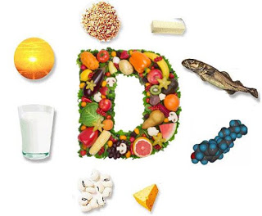

Is Vitamin D “Heart Healthy”?
JL Vacek. American Journal of Cardiology 2012.
@fperrywilson
Notes:
Monitor 3

Slide 17

Is Vitamin D “Heart Healthy”?
JL Vacek. American Journal of Cardiology 2012.
@fperrywilson
Notes:
Monitor 3

Slide 18
Observational / Randomized Trial Disconnect – Vitamin D
Disease Condition | Observational Study | Randomized Trial
Cancer | Low levels = More cancer | 26,000 patients supplement vs. placebo – no difference
Cardiovascular disease | Low levels = More cardiovascular disease | 26,000 patients supplement vs. placebo – no difference
Diabetes | Low levels = more diabetes incidence | 2,400 pre-diabetics supplement vs. placebo – no difference
Falls | Low levels = more falls | 409 at-risk supplement vs. placebo – no difference
All-cause mortality | Low levels = more deaths | 36,000 women vitamin D vs. placebo – no difference
Manson et al, NEJM 2019. Pittas et al NEJM 2019. LaCroix et al, J Gerontol 2009.
@fperrywilson

Slide 19
Exercise
Predict systolic_max based on age (in years).
What is the y-intercept?
For each additional year of age, what happens to blood pressure?
Is the change above significantly different than 0?

Slide 20
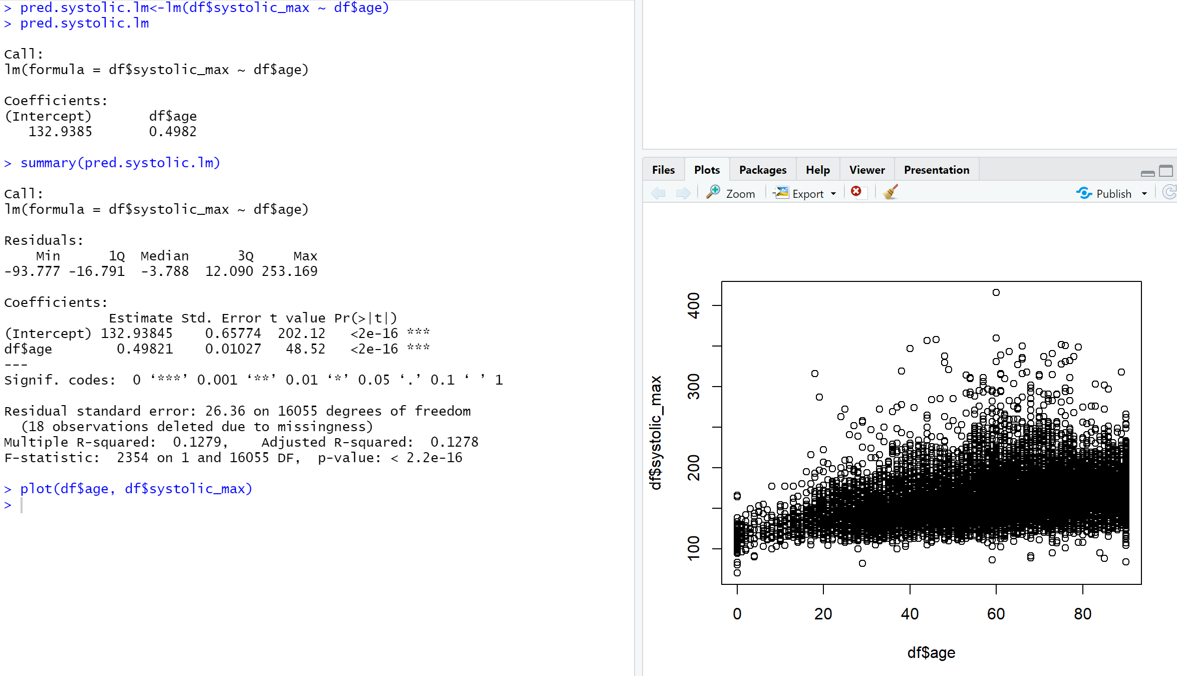

Slide 21
Exercise
Predict systolic_max using age, femalesex, and diastolic_max
In this model, what is the average difference in systolic_max between female and non-female, assuming all other values are similar?
What percent of the variance in systolic_max is accounted for by this model?

Slide 22
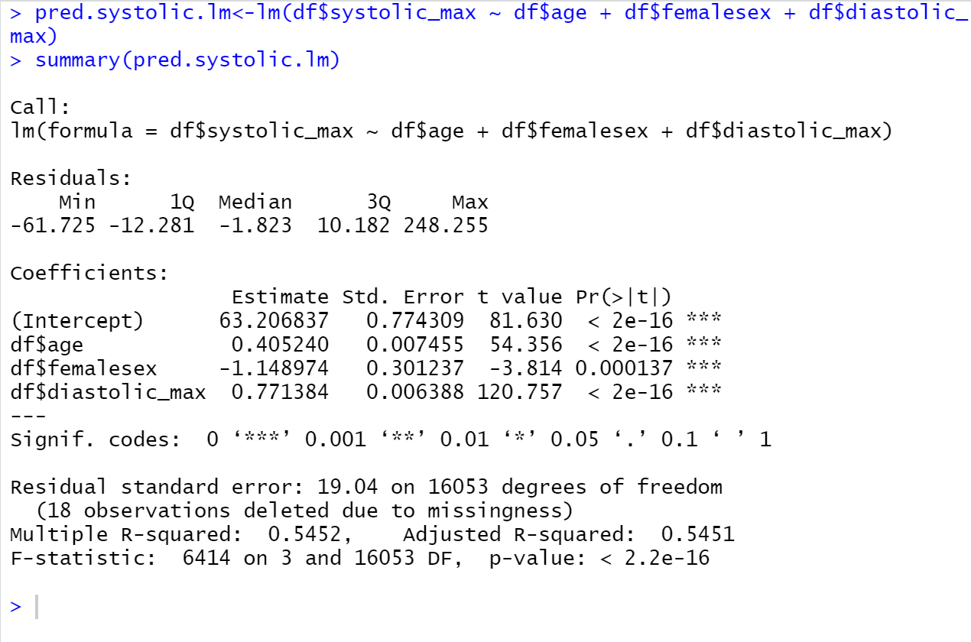

Slide 23
Intuiting the Logistic Function
(Chalkboard)

Slide 24
The math
Probability = 1/(1+e^-X), where X is the some of the coefficients (and intercept) of your model

Slide 25
Exercise
Create a new variable based on the prior model that is the individual predicted systolic_max value for everyone in the dataset
Create a scatterplot of this predicted variable vs the observed systolic_max

Slide 26
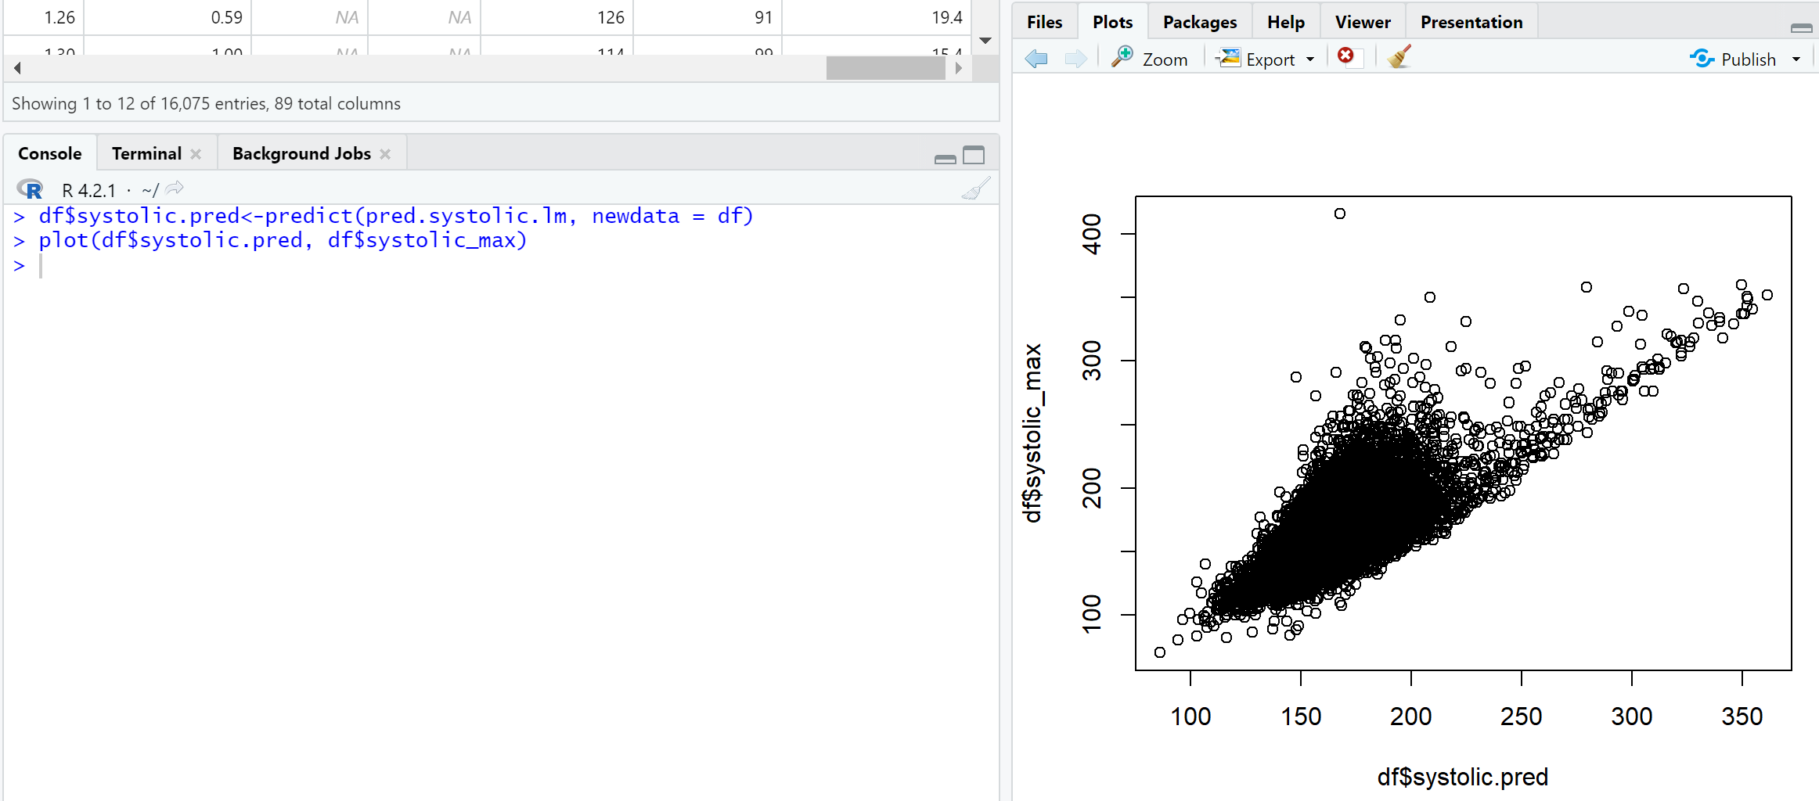

Slide 27
Exercise
Previously, we found that in bivariate analysis, there was a significant relationship between latino ethnicity and death. But that was not present when we stratified by age>65.
What is the OR for death among those who describe themselves as Latino vs. Not?
What is the adjusted OR for death among those who describe themselves as Latino vs. Not, accounting for age?

Slide 28
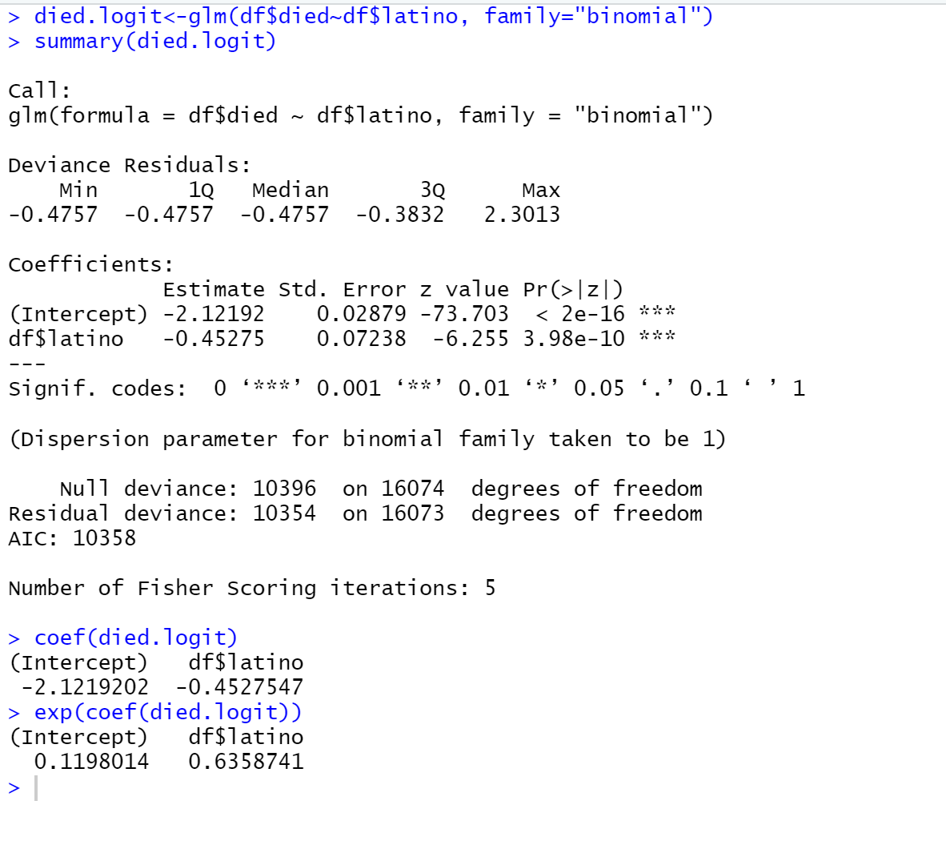
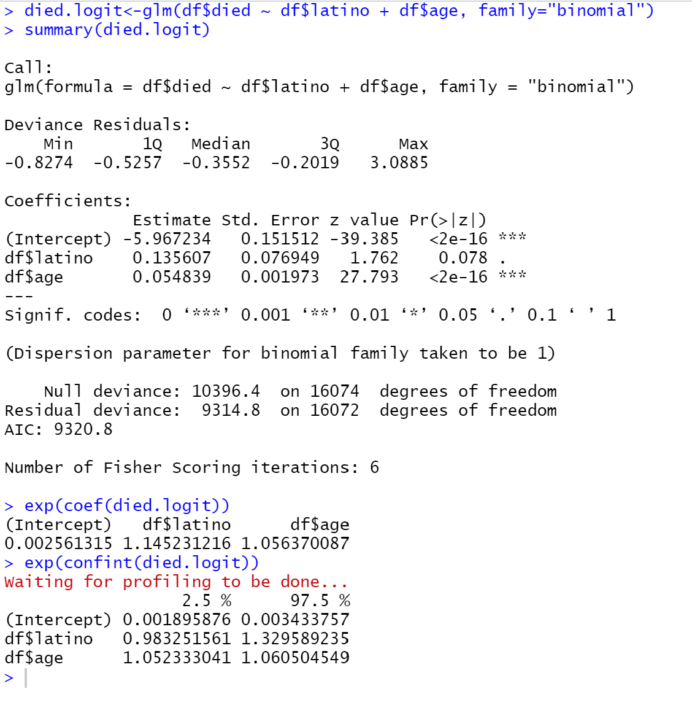
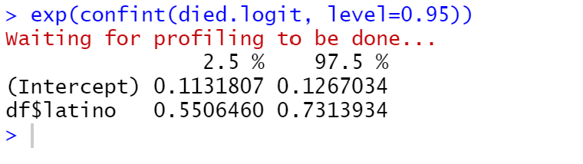

Slide 29
Exercise
Create a model predicting death with the following covariates of interest: age, femalesex, latino, num_vaccine, medical_icu, creatinine_max
Predict the probability of death for each patient in the dataset?
What is the observed mortality rate in the top quintile of predicted risk (eg the 20% of patients with the highest prediction scores?)
What about the lowest quintile?

Slide 30
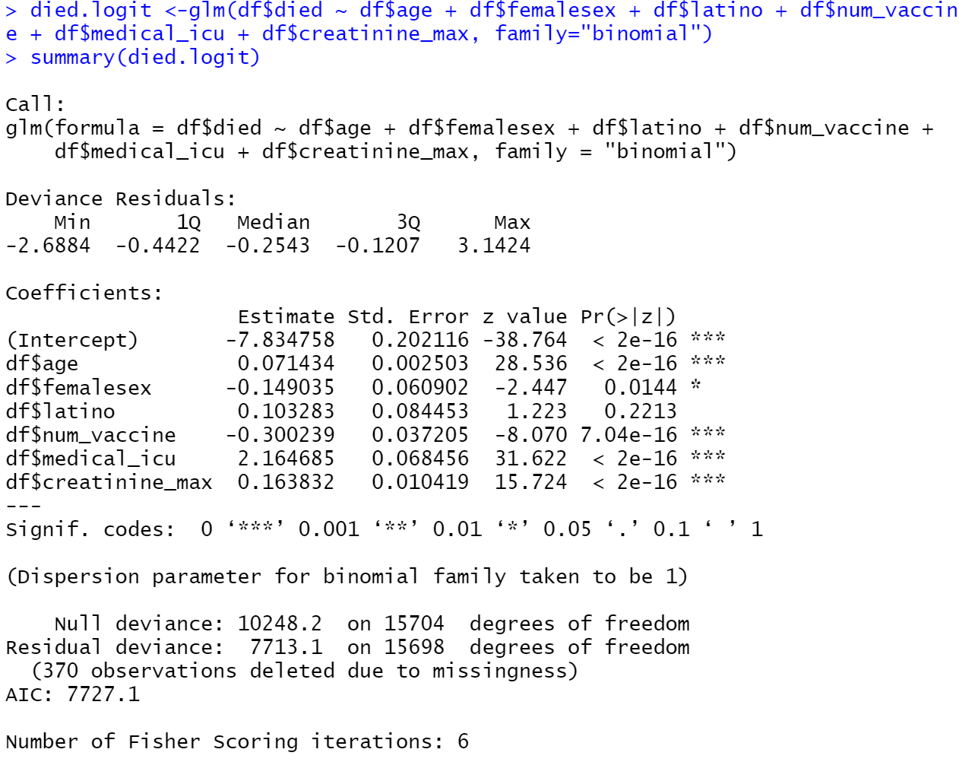
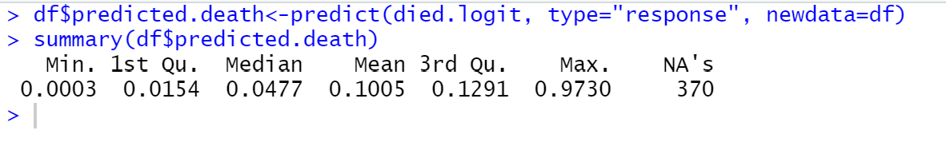
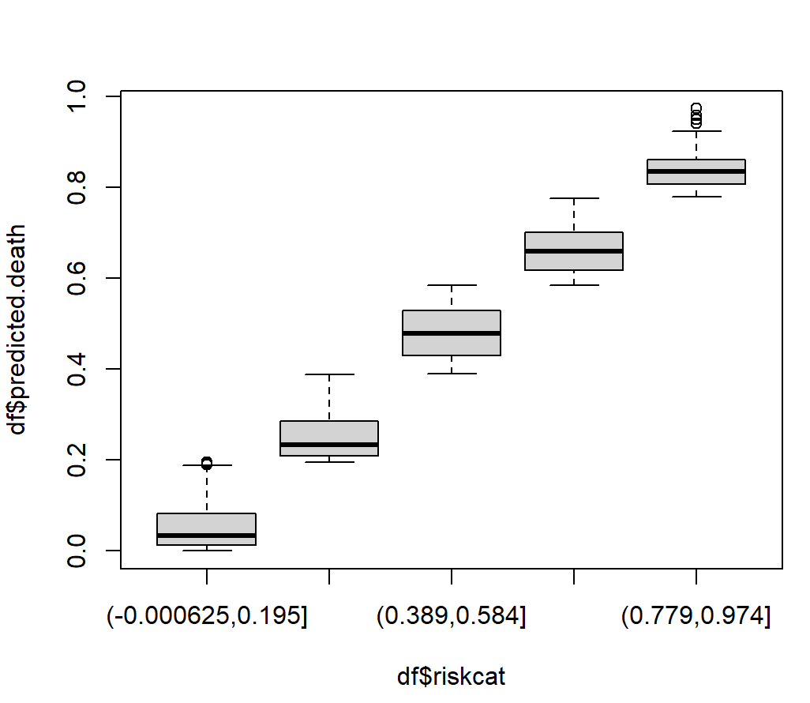

Slide 31
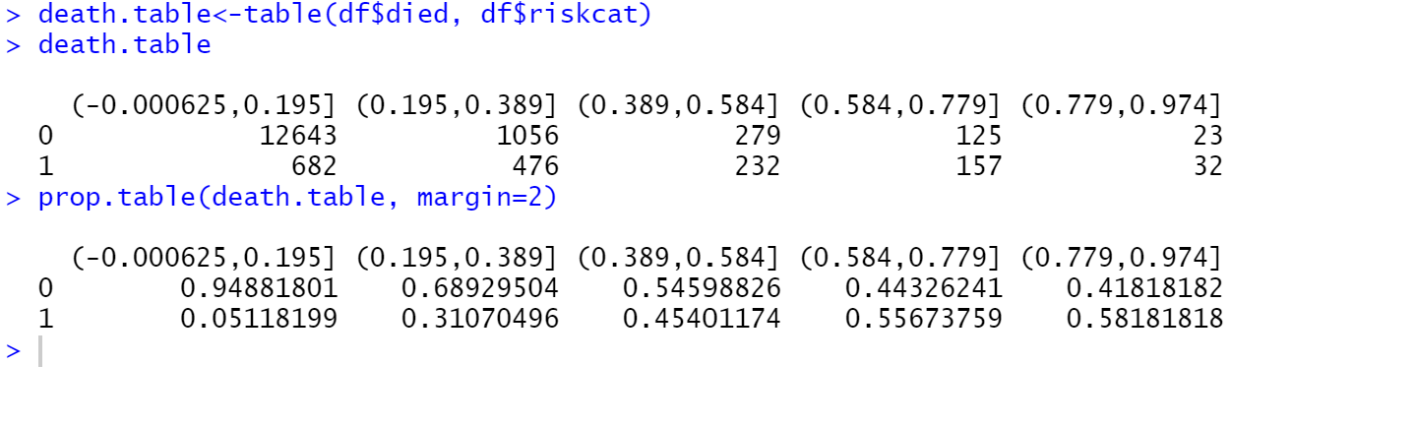

Slide 32
Extra Time?

Slide 33

Remember Firefly?
Notes:
I’d like to put in the first 15 seconds of this clip here: https://www.youtube.com/watch?v=znxFrgql5dc

Slide 34
What we can learn from a great sci-fi western
Firefly left us after just one season
Television shows, like people, have a life-span that varies, but they vary in a very specific, non-normal way
Notes:
Monitor 1: An icon of a person saying “bring back firefly”

Slide 35
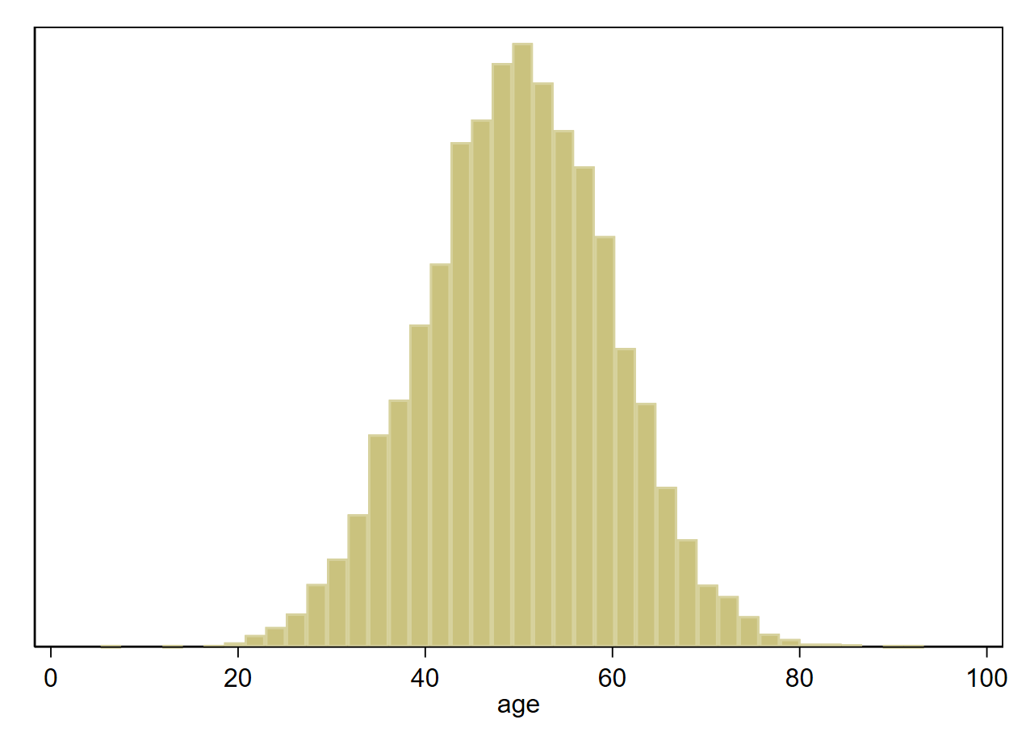
Survival is NOT Normal
The age of death is NOT normally distributed. It doesn’t look like this:
Notes:
Monitor 2: Grim reaper

Slide 36
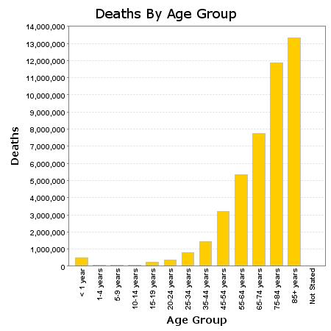
It looks like this
Source: wonder.cdc.gov
Notes:
Monitor 2: grim reaper

Slide 37
Why?
Because survivors are more likely to survive
Age | Life-Expectancy (Female)
0 | 81.1
50 | 83.24
65 | 85.4
80 | 89.7
90 | 94.9
Notes:
Monitor 2: grim reaper

Slide 38
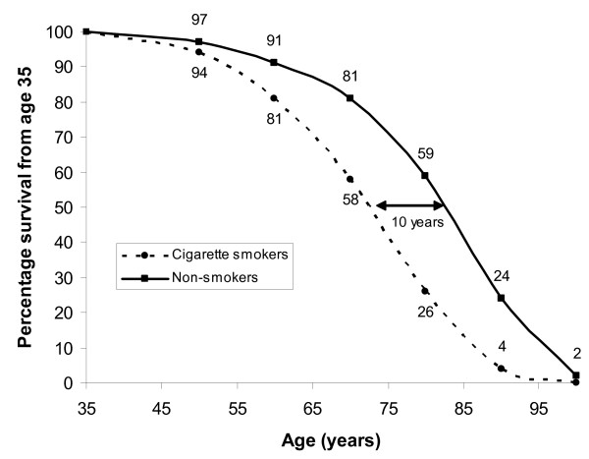
The Kaplan-Meier Curve
Notes:
Monitor 3: grim reaper

Slide 39
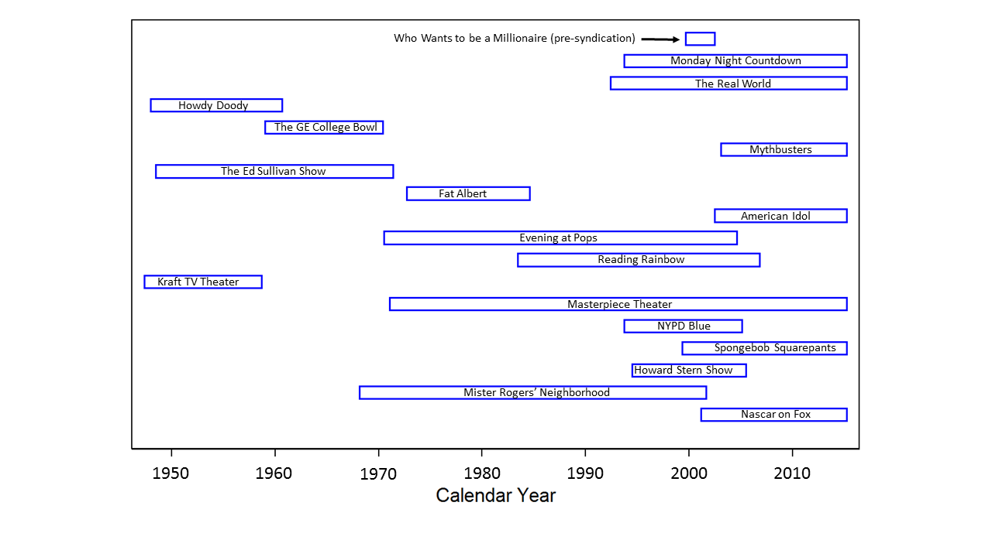
TV Show Survival
Notes:
Monitor 3: dead television set

Slide 40
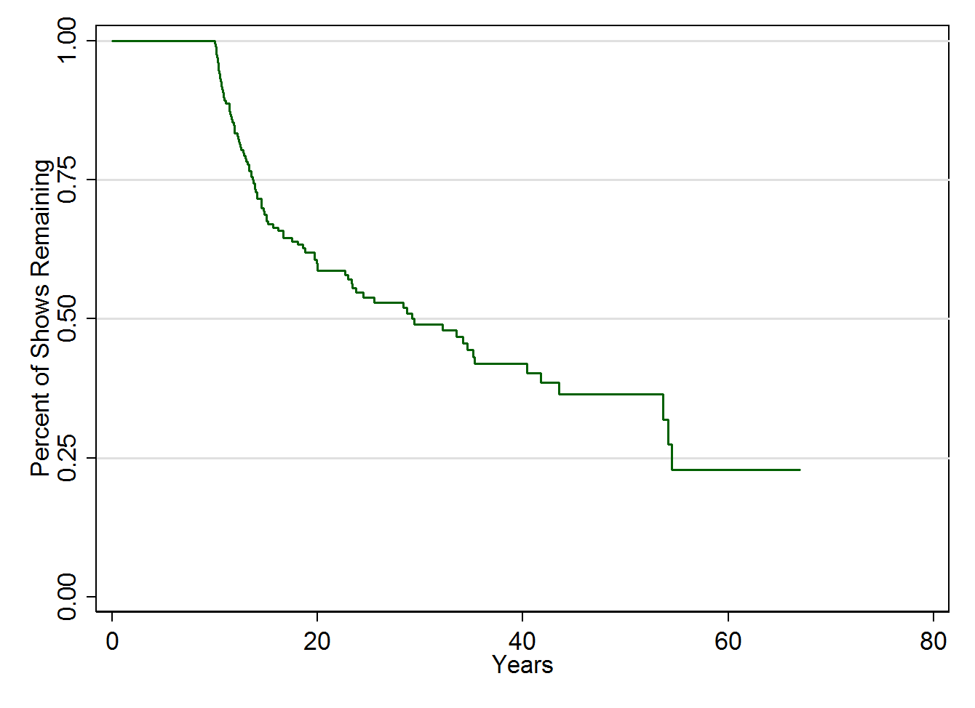
TV Show, Kaplan Meier Style
Notes:
Monitor 3: dead television set

Slide 41
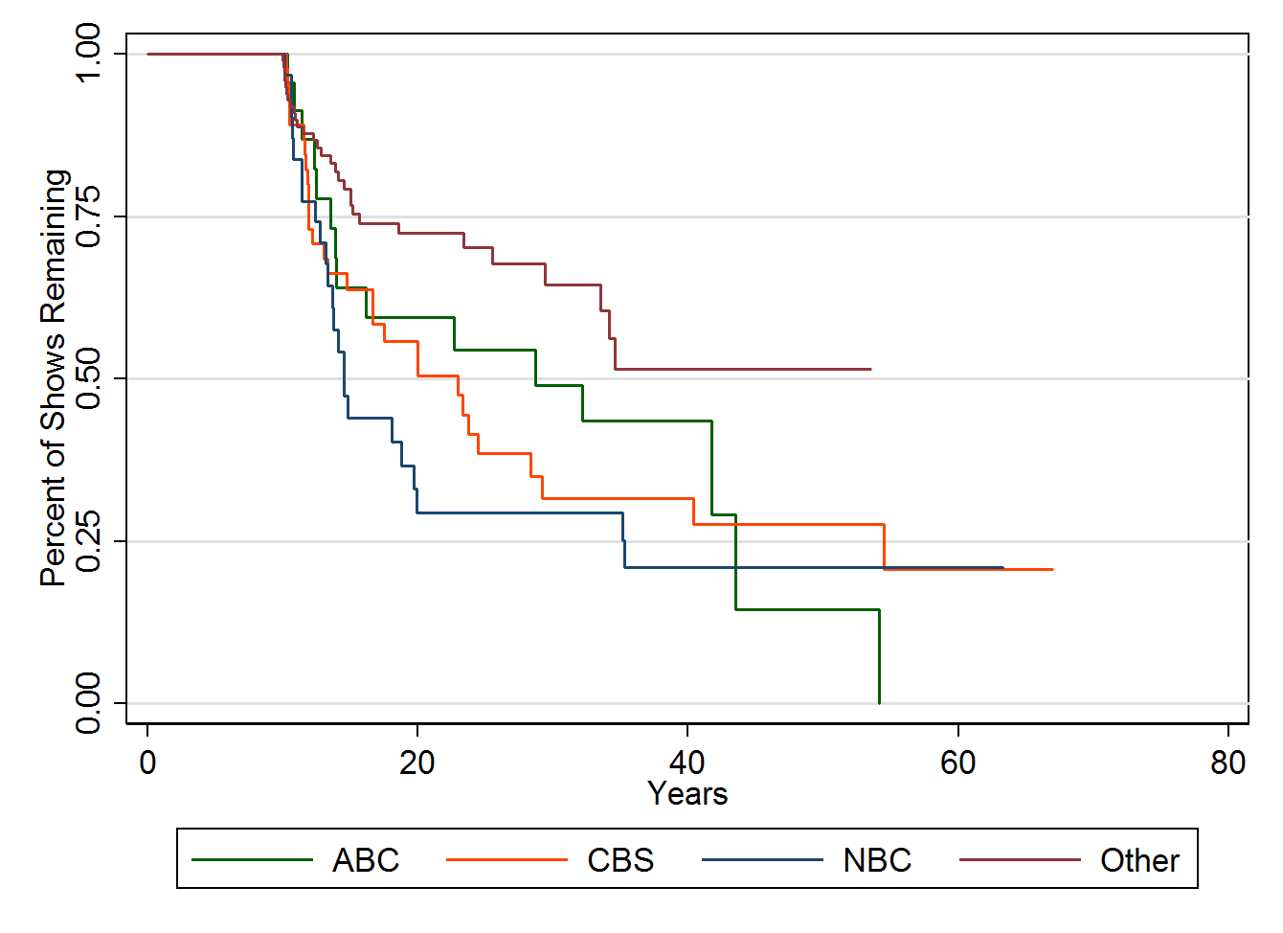
TV Show, Kaplan Meier Style
Notes:
Monitor 3: dead television set, logos of ABC/ CBS/ NBC

Slide 42
In Survival Analyses, Groups are Compared using a Hazard Ratio
(It’s basically the same as a relative risk)
Hazard Ratio (vs. “other”)
ABC: 1.8
CBS: 2.0
NBC: 2.5
Notes:
Monitor 3: Maybe the Logos of ABC/CBS/NBC

